Slide 1
CTSO State-wide Training
Welcome Educators Rising Chapter Leaders!

Slide 2
Agenda
Today we will
  Celebrate last year’s successes!
  Discuss our goals and fears for the upcoming schoolyear
  Meet our fabulous state officers!
  Plan our program of work, month by month
  Review the competition and event schedule, discuss the specifics of each competition, commit to at least one
  Familiarize ourselves with the national resources as well as the Maryland Ed Rising website resources
  Share details of regional, state and national conferences, discuss costs and fundraising
  Share crosswalk of resources for TAM/CDA/Ed Rising

Slide 3
Did you know??
Maryland currently has 84 high school and middle school chapters with 962 high school student members, ranking 7th in the nation for total membership.

Slide 4
2024-2025 Recap!
What a year!
Annual Report
https://drive.google.com/file/d/17B-8YIeTN0XilFYi1yE3hz999jvO5OTN/view

Slide 5
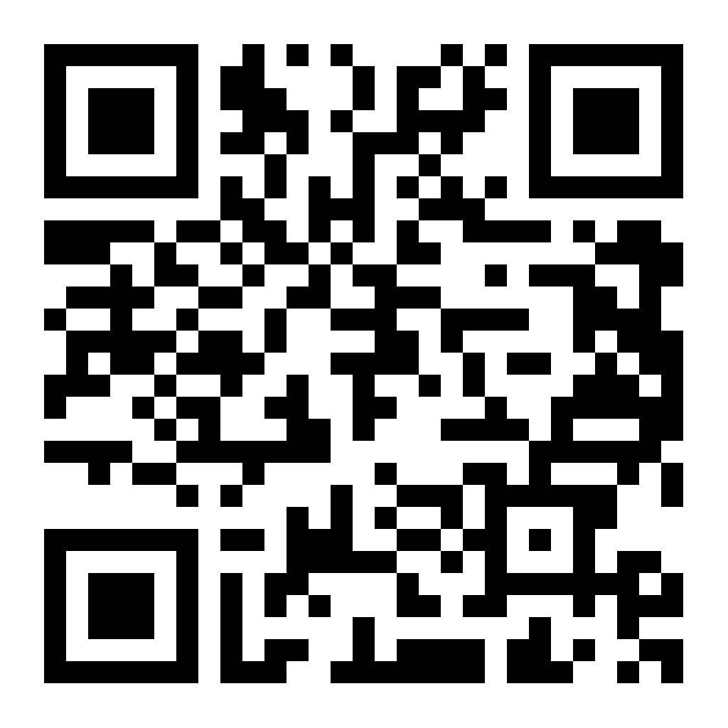
Scan to see our annual report!

Slide 6
2025-2026 Checklist
Conduct Chapter Recruitment Activities
Elect Chapter Officers
Conduct well-planned, regularly scheduled chapter meetings
Complete a Program of Work (List of planned chapter activities for the schoolyear.)
Pay membership dues on all members
Encourage your members to participate in competitions
Attend Local and/or State Conference

Slide 7
Link to detailed checklist
Detailed Checklist
https://docs.google.com/document/d/19Cd-sNce6aPizgDm7mT0JNbDbktZvFgfLeLfcbJ1ApM/edit?tab=t.0

Slide 8
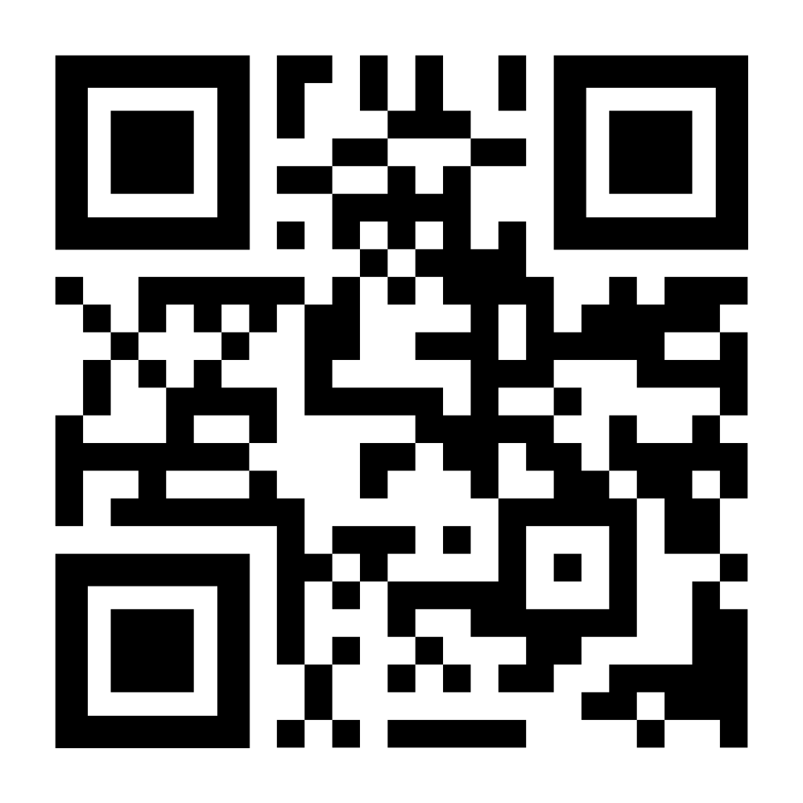
Scan to view detailed checklist

Slide 9
Goals and fears for this year?
Please take some post-its from the center of your table. Write a goal on one and a fear on another. (Or use multiple if you wish!). Place the post-its on the appropriate poster boards in the room.

Slide 10
Sample Program of Work
In your folders, there are printed Programs of Work
These are suggestions from nationals, there is NO WAY you could do all of them!
Choose a highlighter from your table and highlight the activities that you feel you could accomplish each month, in addition to your standard meetings
Complete your “Calendar of Activities” form at your table, be sure to look at the “Dates to Know” document
Save space to add in a competition or two during the year!
We will be building your chapter’s program of work today

Slide 11
Teacher Leader Meetings
9/9 – Kick-off at Maritime Conference Center
The following are virtual, at 3:30
9/11 (if you missed the 9/9 meeting)
10/9
12/4
2/12
3/2
5/14

Slide 12
Fall Leadership Conference!
Conference Flyer
https://www.canva.com/design/DAGwKIcFEmQ/1w4qAbAtescVtPG-wzR2iw/edit

Slide 13
State and National Conferences!
MD State Conference
April 30th & May 1st, 2026 at Towson University
One-day conference
A day is packed with informative, interactive sessions that will help students get excited about a career in teaching
National Conference
6/20 - 6/23, 2026
“Teach with Purpose, Lead with Passion”
Portland, Oregon

Slide 14
Competition Participant Levels
4 levels of participation
Middle School level — Grades 7, 8
High School Junior Varsity level — Grades 9, 10
High School Varsity level — Grades 11, 12
Collegiate level – Undergraduates only
Not all competitions are open to all divisions
Teams consisting of students from varying grade levels will be placed in the division for the grade level of the most senior member.

Slide 15



Types of competitions/contests
Individual – only one student
Individual or Dual – may consist of one student or two students.
Team – must consist of at least two students and no more than four students.

Slide 16
Middle School (7,8) competitions
Children’s Literature
Creative Lecture (TED Talk)
Educators Rising Moment
Exploring Non-Core Subject Teaching Careers
Interactive Bulletin Board
Teacher Created Materials
ALL competitions/contests are open to JV/Varsity

Slide 17
To compete at Nationals:
You must first make the top ten at state
Students may only participate in ONE NATIONAL event
Teachers may enter two students per school in each national event and one team for any team event
THREE students per level can compete at the state level, but ONLY TWO can be ranked in the top ten and sent forward to nationals (This is new)

Slide 18
Changes this year
Only 3 students per division, per competition, at the state level
Only 2 students per division, per competition, at the national level
EVERY competition has a pre-scored component. All prescored materials must be sent to Edrising.prescore@gmail.com, at least one full week before the competition. If prescored materials are not received, that competitor will be removed from that competition.
Some competitions are virtual, others are in person, please check the schedule
Scholarships for nationals are not automatically given to the first-place winners. This year it will be an application process.

Slide 19
Competition vs Contest
COMPETITIONS
Score against a rubric and compare performances of each student against their peers.
Only the top 10 places are recognized
CONTEST
Score against a rubric of excellence for a total score
Ribbons will be awarded to students in each category in each division with scores as follows:
Blue-Scores 98-100
Red-Scores 94-97
White-Scores 90-93
Can have multiple students who receive the top scores

Slide 20
MD Competition schedule
Competition Schedule
https://docs.google.com/document/d/13oCRhq9NmpZhVa2d-uk4DbhqE4Htt4nPNbdZWOymIZ8/edit?tab=t.0

Slide 21
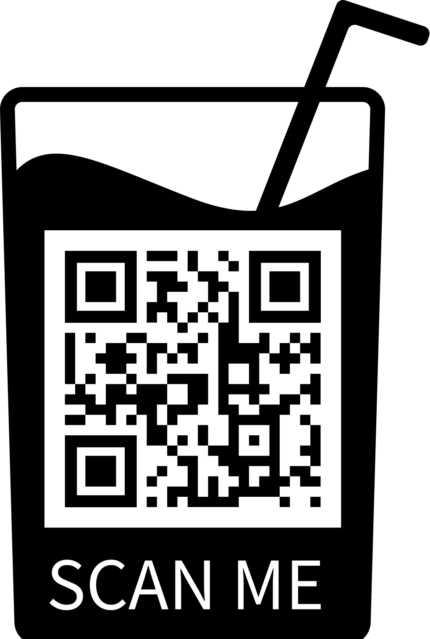
Link to Competition Schedule

Slide 22
Take 15 minutes to explore the MD schedule of events
Jot your questions on your questions sheet
We will answer questions after 15 minutes

Slide 23

Questions?

Slide 24

Grab a post-it and write the name of the competition you are committing to this year! (You can do it officially or as a chapter exercise.) Place it on the appropriate posterboard.

Slide 25
Resources
State Level Teacher Leader Resources: https://www.edrisingmd.org/
Resources Link

Slide 26
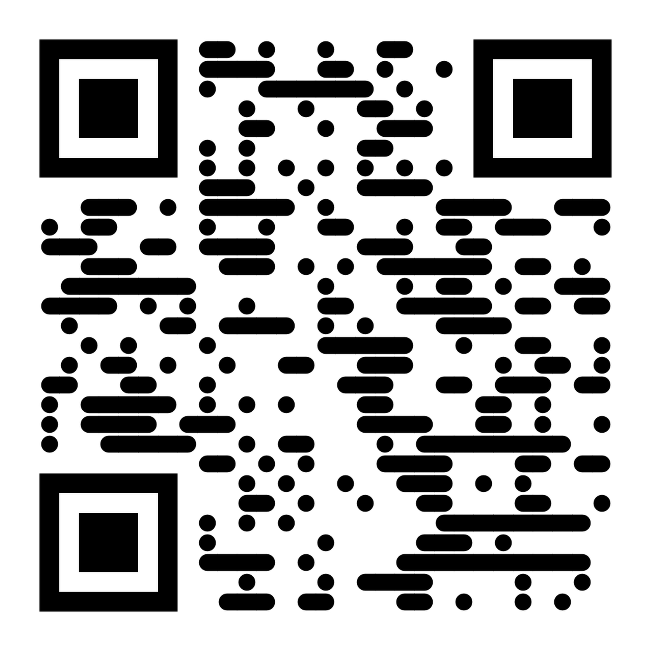
MD Ed Rising Website

Slide 27
National Teacher Leader Resources: https://educatorsrising.org/tl-landing/
National Resources Link

Slide 28
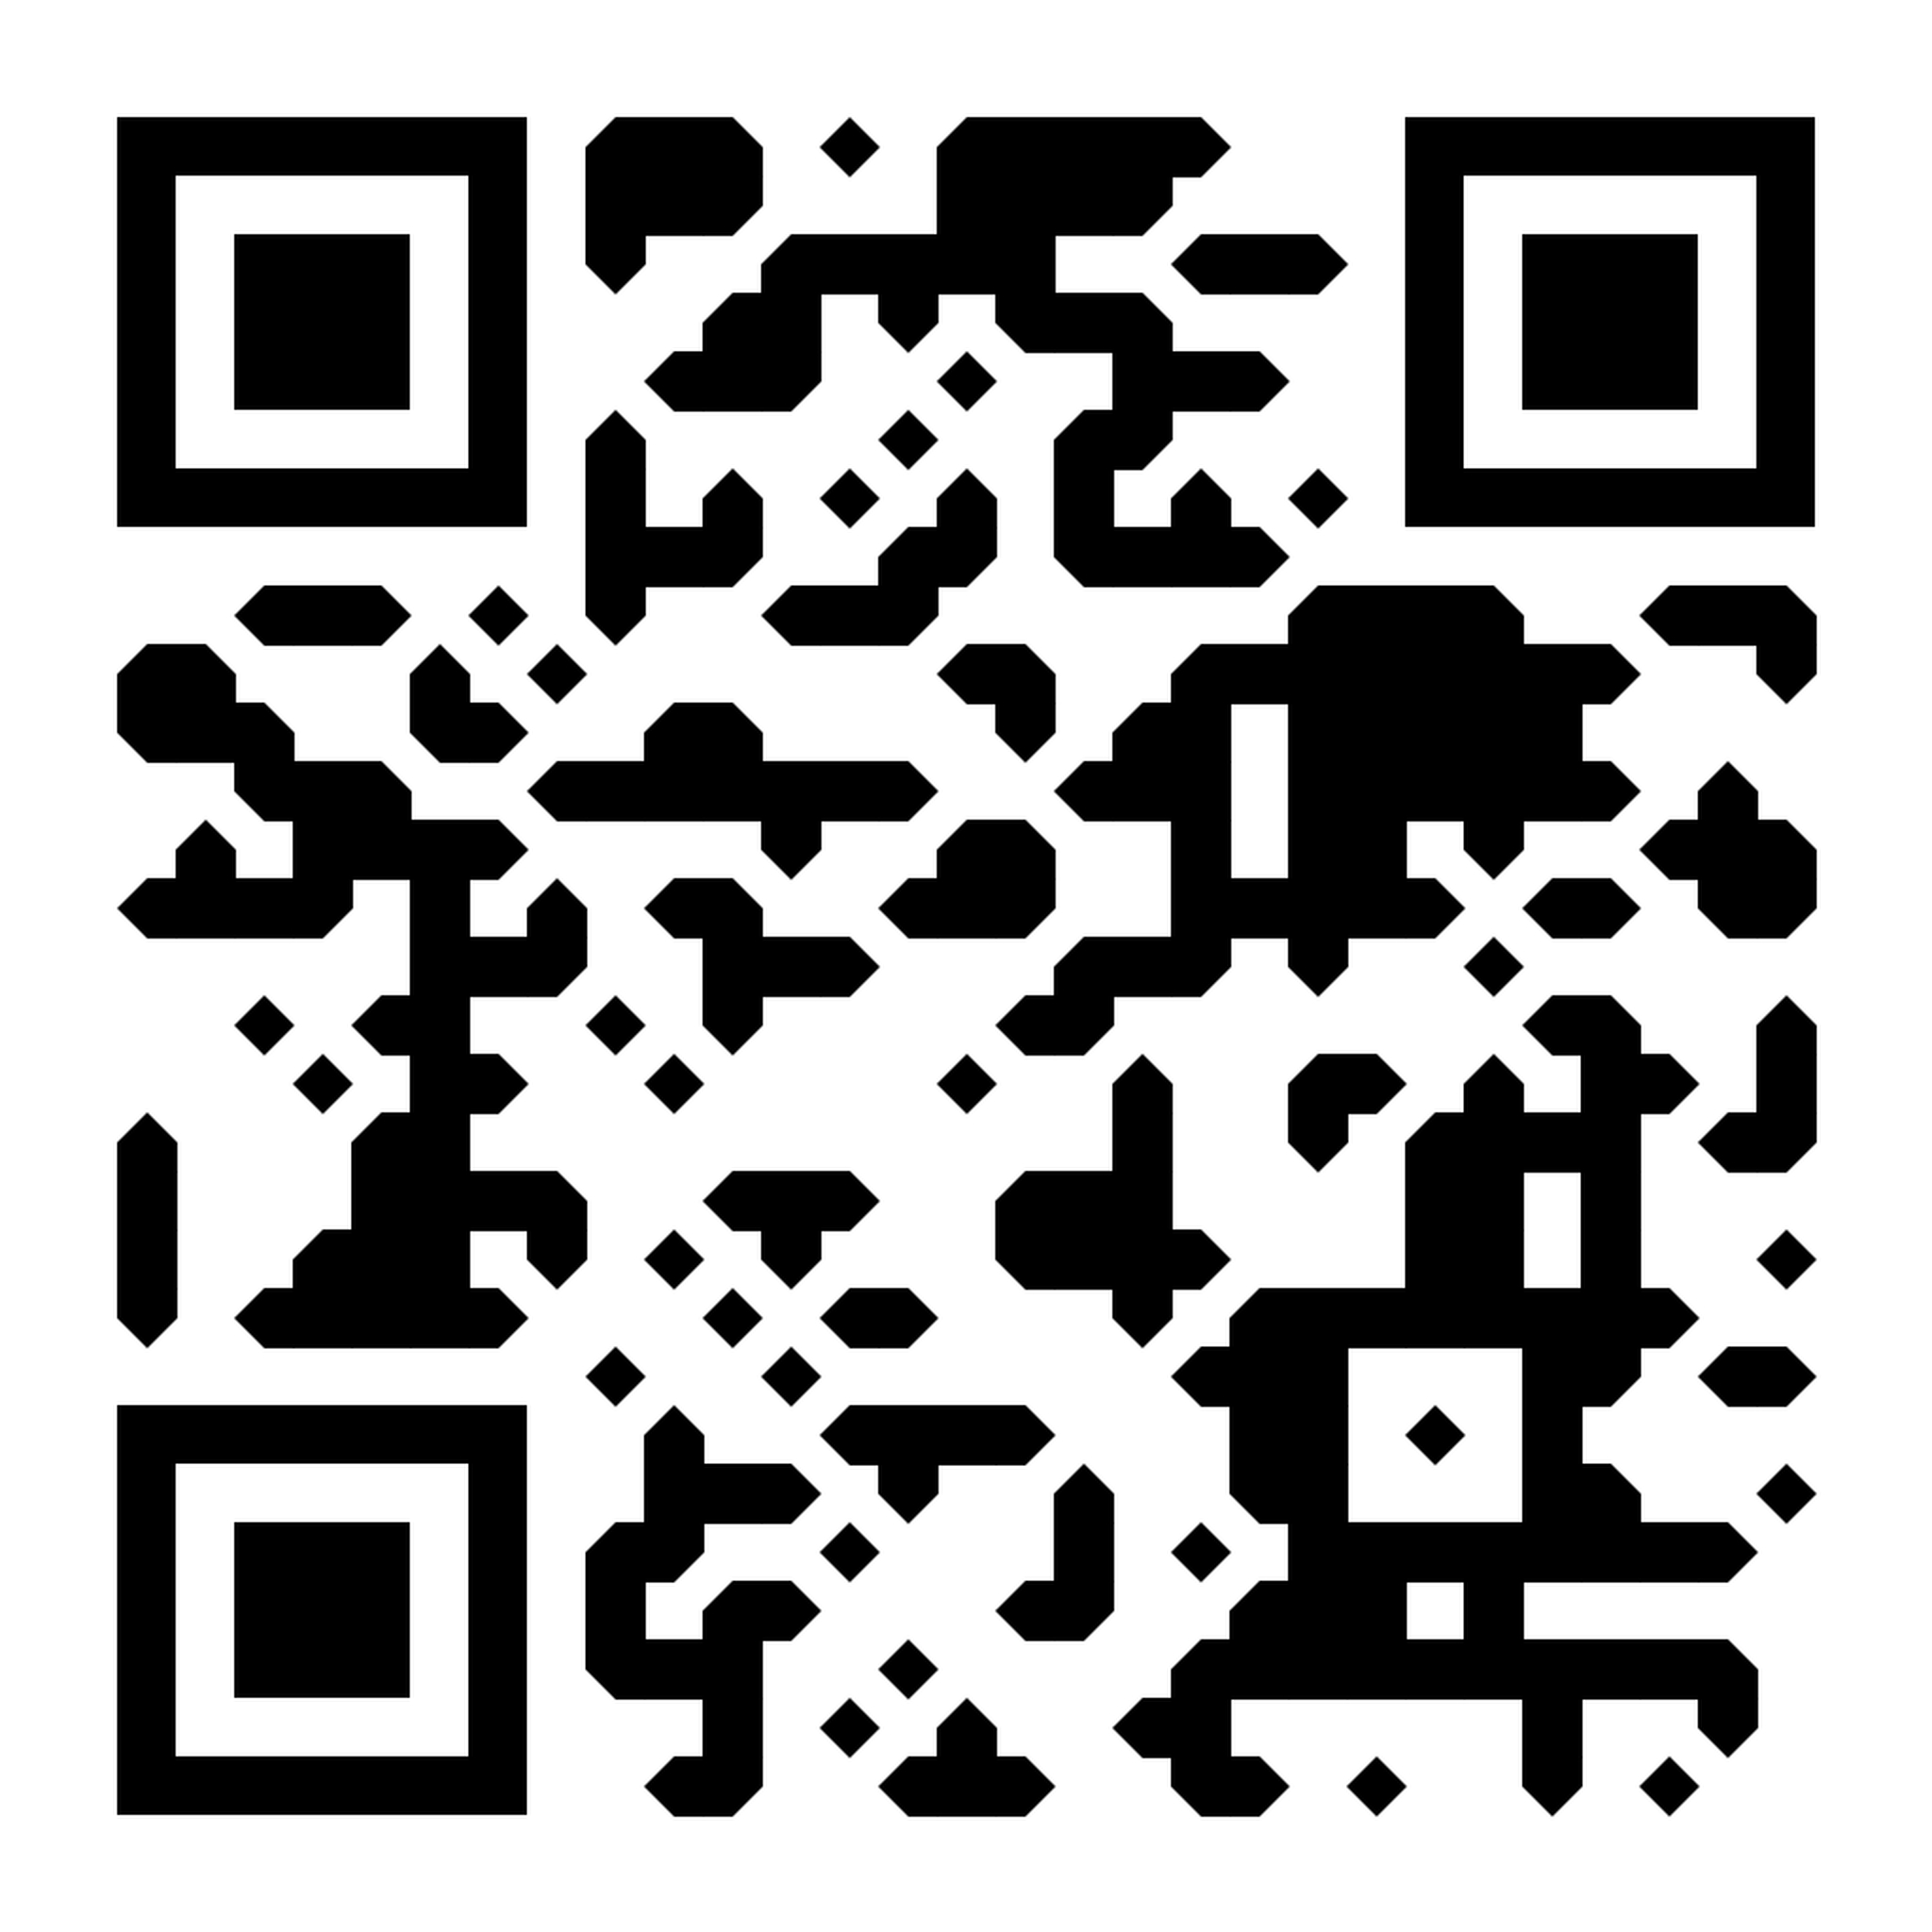
Explore the national resources for 10 minutes.
Find the Ed Rising Letterhead! Find the online micro-courses for Teacher Prep! Check out the Teaching Channel videos!

Slide 29
Fundraising
Chapters do different things!
#1 most successful fundraiser has been the letter writing campaign
Any other suggestions?

Slide 30
TAM/Ed Rising Crosswalk
Link to Crosswalk
https://docs.google.com/document/d/1Y_T8o_gX54_P5SVOYKDbLbdvtxF3eJjkbYz6FfFB1gI/edit?tab=t.0

Slide 31
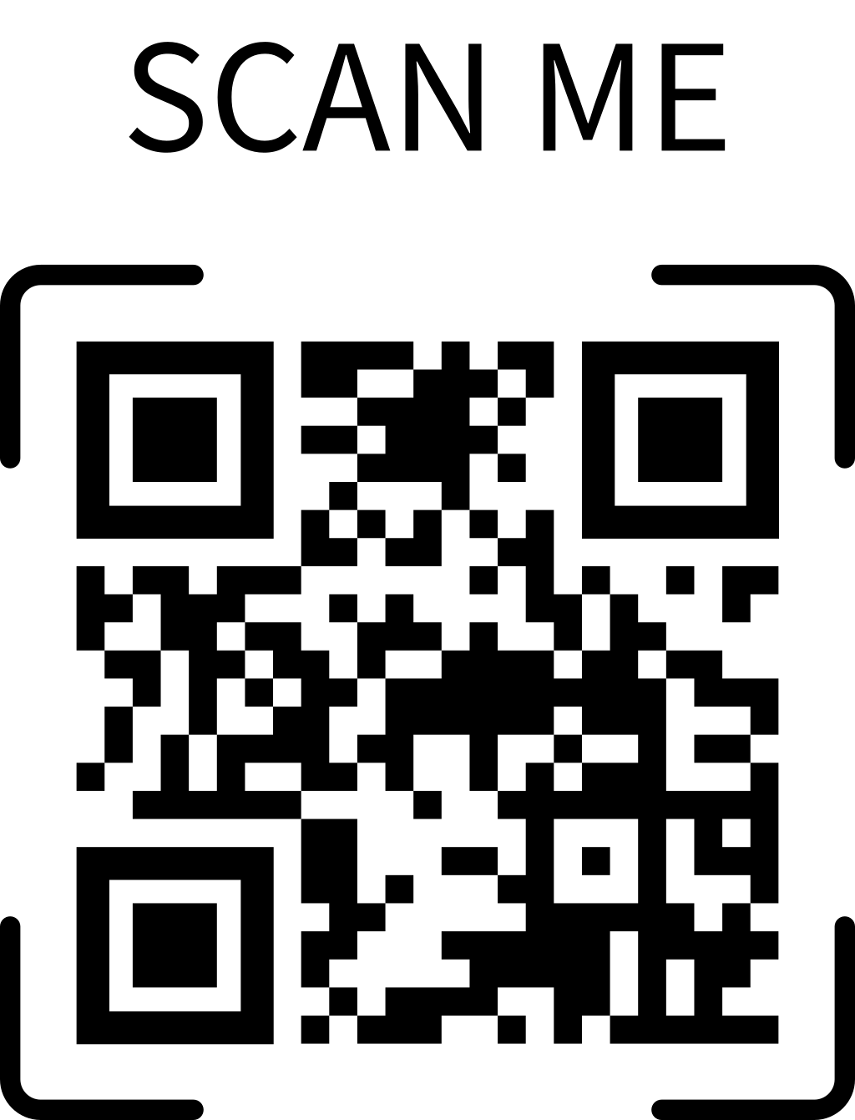
Link to Crosswalk

